Slide 1

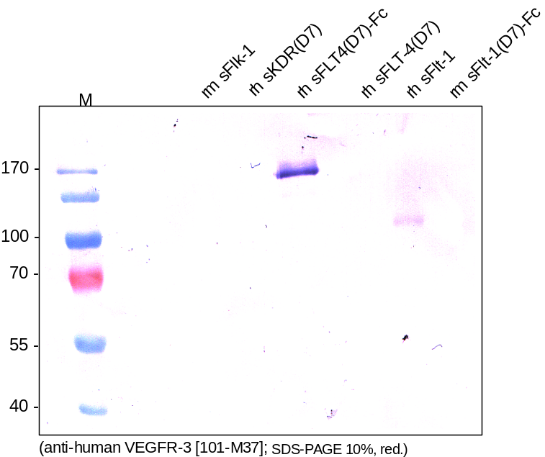
ReliaTech GmbH
Mouse anti-human VEGFR3/FLT-4 (#2E11)
(Cat #101-M37)
Figure 1. Western analysis with different recombinant soluble VEGF receptor proteins using a monoclonal anti-human VEGFR-3/FLT-4 antibody [Cat# 101-M37]. There is no cross reactivity visible with mouse sFlk-1, human sKDR and mouse sFlt-1 but a weak one with human sFlt-1.
http://www.reliatech.de / info@reliatech.de

